Slide 1
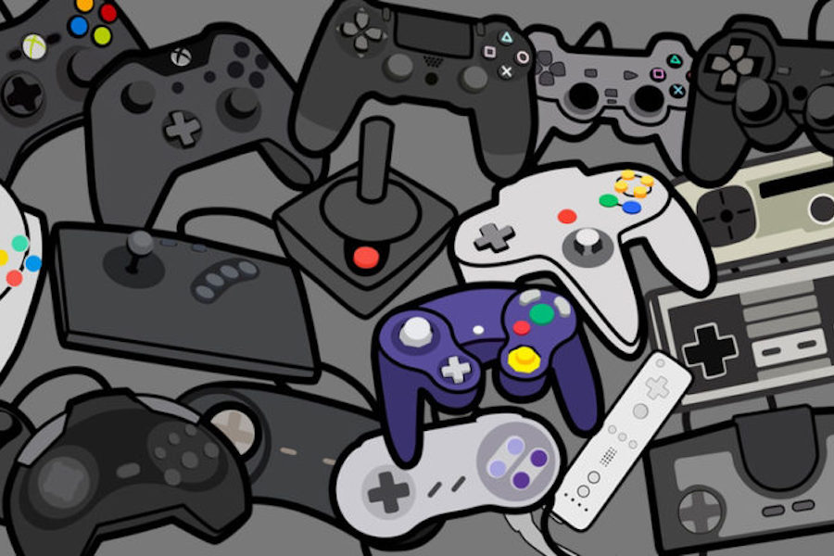
Reinforcement Learning for Dynamic Difficulty Adjustment
Replicating and building upon "Go with the Flow" (Pagalyte et al., IVA 2020)

Slide 2
The Challenge
Why Dynamic Difficulty Adjustment?
Games that are too easy, implies players lose interest
Games that are too hard , implies players get frustrated
Traditional solution: manual difficulty tuning (time-consuming, inflexible)
Goal: Agent that automatically adapts to player performance
Research Question: Can SARSA + reward-sign inversion create balanced, engaging gameplay?

Slide 3
My Approach
Game Environment
DDA Mechanism
Turn-based battle system
Both start at 75 HP
4 actions: Hit, Charge, Combo, Heal
17-state model (HP bands)
SARSA reinforcement learning
Tracks win/loss streaks
After 5 win/loss streak: flip reward signs
Agent tries harder or easier

Slide 4
Difference from the Original Implementation
Original Paper
My Implementation
4 human participants
30 battles per configuration
5 actions for human (included "Flee"). 4 for the agent.
10 game configurations
GEQ questionnaire for engagement
Limited statistical power
Simulated human-like player
3,000 battles per configuration
4 actions (removed "Flee”)
5 agent types tested
Quantitative metrics: win rates, pacing, action distributions
100x more data for statistical validity

Slide 5
Key Adaptation
Removing Human participants enabled me to scale up the evaluation drastically.

Slide 6
Experimental Setup
5 Agent Configurations Tested
SARSA + DDA (ε=0.3) - 30% exploration
SARSA + DDA (ε=0.5) - 50% exploration
SARSA without DDA - ablation baseline
Fixed Easy Agent - defensive, predictable
Fixed Hard Agent - aggressive, minimal healing
All these agents were tested using 3,000 battles each against the same human-like player model.

Slide 7
Implementation
Code Structure
Reproducibility
Battle environment class
Human-like player model
SARSA agent with DDA
Scripted baseline agents
Experiment runner
Single Notebook file
No external dependencies
Fixed random seeds
Complete visualizations
CSV export for additional analysis

Slide 8
Key Results
Agent Type | Player Win % | Agent Win % | Avg Battle Length
SARSA + DDA (30/70) | 60.1% | 39.9% | 10.58 turns
SARSA + DDA (50/50) | 67.0% | 33.0% | 10.67 turns
SARSA No DDA | 55.9% | 44.1% | 9.89 turns
Fixed Easy | 98.7% | 1.3% | 12.14 turns
Fixed Hard | 61.9% | 38.1% | 9.27 turns

Slide 9
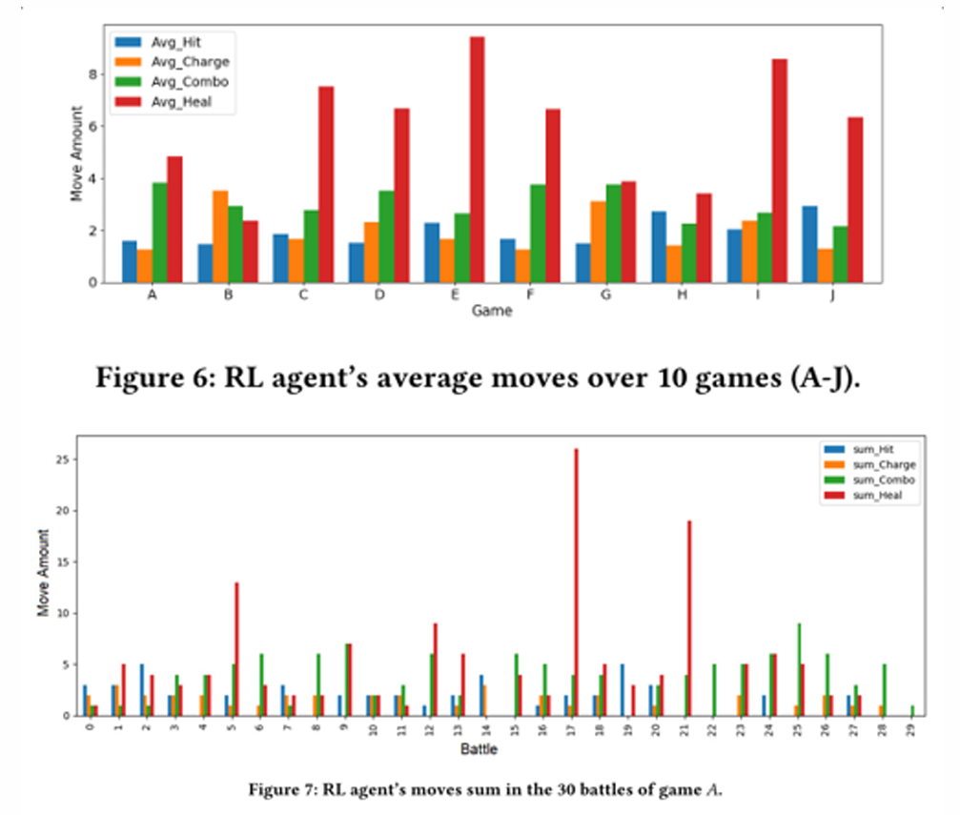
Original Paper Results

Slide 10
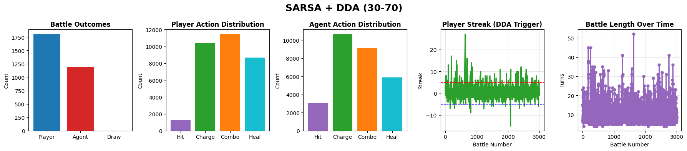
SARSA + DDA (30/70)
Player Action Counts: Combo: 11431, Charge: 10374, Heal: 8680, Hit: 1257
Agent Action Counts: Charge: 10644, Combo: 9138, Heal: 5903, Hit: 3057

Slide 11
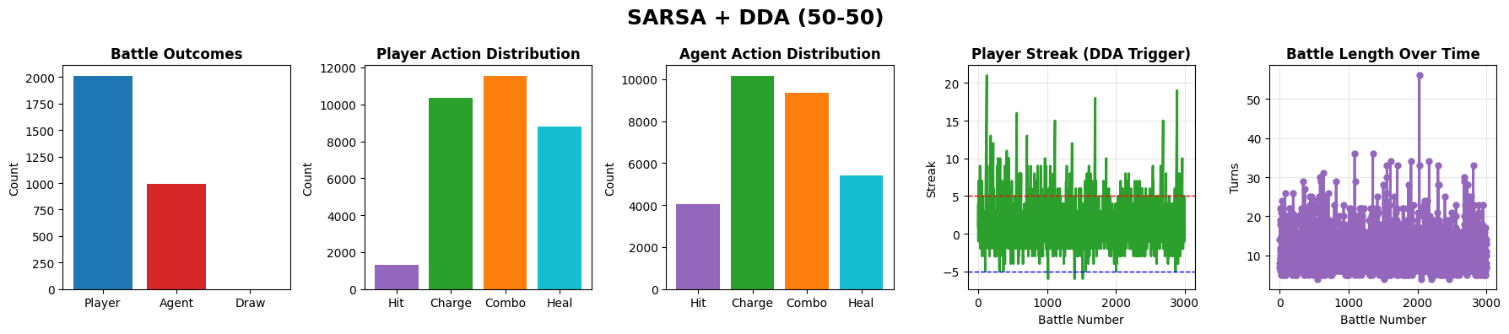
SARSA + DDA (50/50)
Player Action Counts: Combo: 11544, Charge: 10362, Heal: 8788, Hit: 1307
Agent Action Counts: Charge: 10156, Combo: 9361, Heal: 5420, Hit: 4064

Slide 12
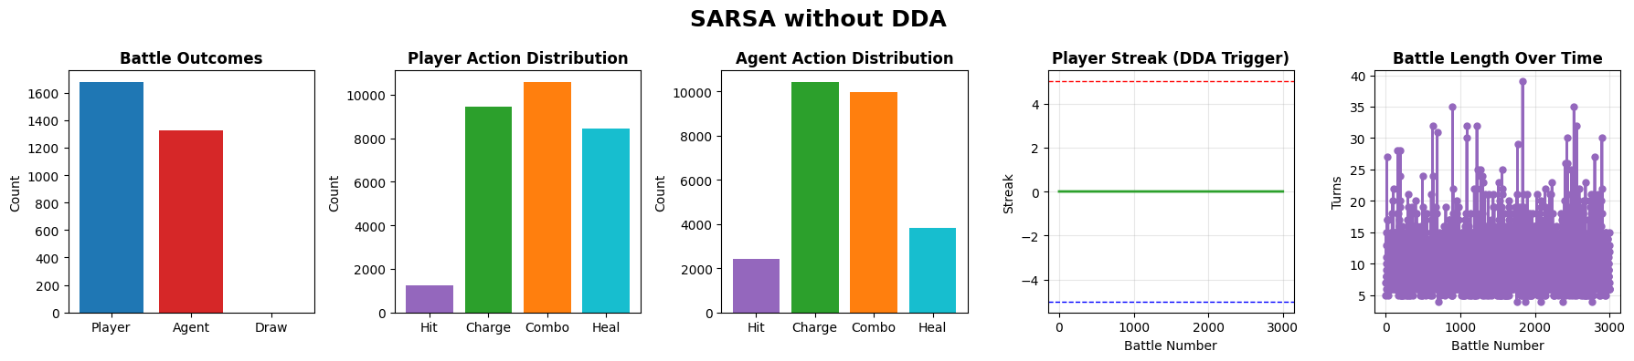
SARSA No DDA
Player Action Counts: Combo: 10582, Charge: 9442, Heal: 8431, Hit: 1228
Agent Action Counts: Charge: 10428, Combo: 9972, Heal: 3843, Hit: 2440

Slide 13
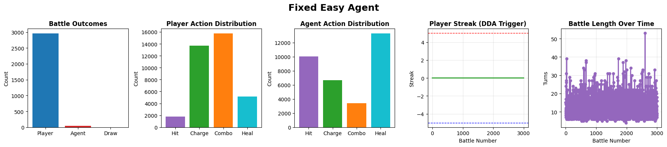
Fixed Easy Agent
Player Action Counts: Combo: 15748, Charge: 13714, Heal: 5164, Hit: 1791
Agent Action Counts: Heal: 13305, Hit: 10056, Charge: 6651, Combo: 3405

Slide 14
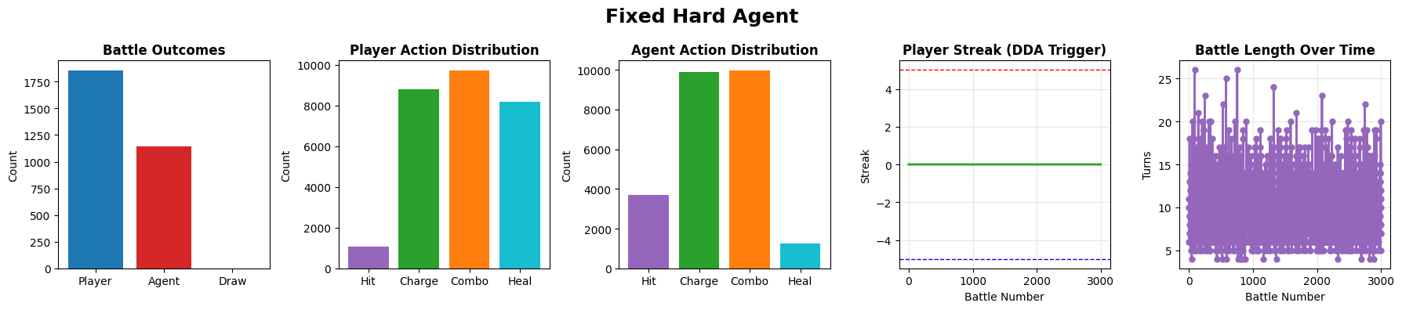
Fixed Hard Agent
Player Action Counts: Combo: 9725, Charge: 8813, Heal: 8198, Hit: 1059
Agent Action Counts: Combo: 9973, Charge: 9907, Hit: 3680, Heal: 1235

Slide 15
Key Insights
DDA Works Without Destabilizing Learning
All SARSA variants maintained balanced, competitive gameplay (56-67% player win rate)
RL Agents Learned Coherent Strategies
High healing frequency, mixed offensive actions - demonstrated survival understanding
DDA Smoothed Performance
Reduced win/loss streaks and stabilized pacing compared to no-DDA baseline
Higher Exploration Performed Better
50/50 exploration led to smoother long-term balance

Slide 16
Limitations & Future Work
Current Limitations
Future Directions
Simulated player (not real humans)
Small action space (4 actions) and simple combat mechanics, doesn’t account for real world game mechanics
Fixed DDA threshold (5 win/loss streak)
Deeper action spaces
Policy gradient methods
Continuous DDA mechanisms
Multi-agent scenarios
Multiple human tests with hundreds of participants

Slide 17
Conclusion
SARSA + DDA maintains balanced, engaging gameplay without manual tuning
Takeaways:
DDA provides subtle but meaningful difficulty adjustment
Reward-sign inversion is stable and effective
RL agents can learn coherent strategies in stochastic environments
Results closely align with original paper (Pagalyte et al., 2020)

Slide 18
Thank You!
Open to Questions
Joseph Nikhil Reddy Maramreddy
yue15
github.com/JoNinto7
Original Paper: Pagalyte, Elinga & Mancini, Maurizio & Climent, Laura. (2020). Go with the Flow: Reinforcement Learning in Turn-based Battle Video Games. 1-8. 10.1145/3383652.3423868.

